Slide 1
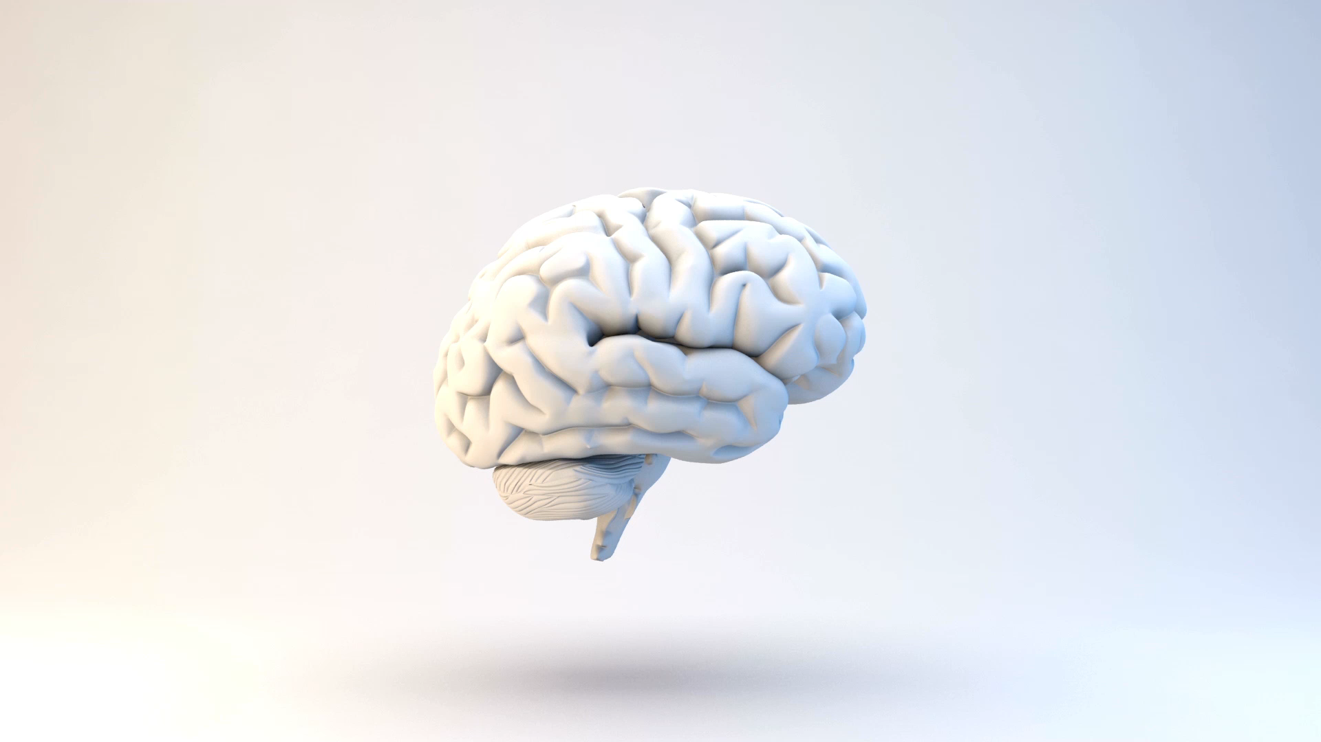
CHAPTER 3 Neurons, Neural Networks, and Linear Discriminants
Suraj Ramchand Alex Milne
Notes:
In computational terms the brain does exactly what we want. It deals with noisy and even inconsistent data, and produces answers that are usually correct from very high dimensional data (such as images) very quickly. All amazing for something that weighs about 1.5 kg and is losing parts of itself all the time, but its performance does not degrade appreciably
Processing units of the brain. These are nerve cells called neurons. There are lots of them – over 100 billion
Operation: transmitter chemicals within the fluid of the brain raise or lower the electrical potential inside the body of the neuron. If this membrane potential reaches some threshold, the neuron spikes or fires, and a pulse of fixed strength and duration is sent down the axon. The axons divide (arborise) into connections to many other neurons, connecting to each of these neurons in a synapse. Each neuron is typically connected to thousands of other neurons, so that it is estimated that there are about 100 trillion synapses within the brain. After firing, the neuron must wait for some time to recover its energy (the refractory period) before it can fire again.
Model this inside a computer and end up with animal or human intelligence inside a computer. This is the view of strong AI. Plasticity: modifying the strength of synaptic connections between neurons, and creating new connections which in turn allows for learning to occur in the brain

Slide 2
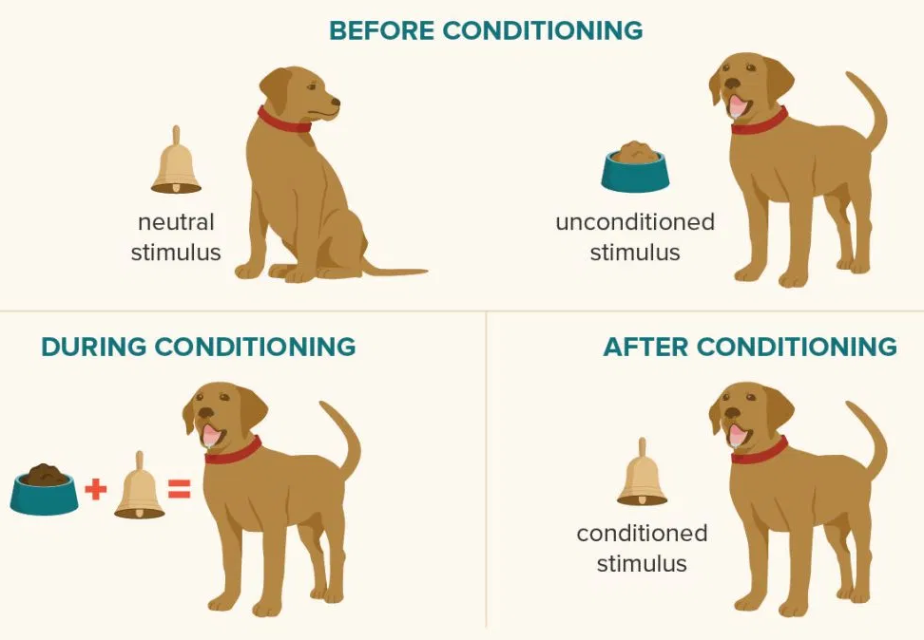
3.1.1 Hebb’s Rule
3.1 THE BRAIN AND THE NEURON
Change in the strength of synaptic connections are proportional to the correlation in the firing of the two connecting neurons.
Classical conditioning (also known as Pavlovian or respondent conditioning)
Notes:
Hebb's rule is a postulate proposed by Donald Hebb in 1949. (read point)
Explain scenario:
If your grandmother always gives you a chocolate bar when she comes to visit, then some neurons, which are happy because you like the taste of chocolate, will also be stimulated. Since these neurons fire at the same time, they will be connected together, and the connection will get stronger over time. So eventually, the sight of your grandmother, even in a photo, will be enough to make you think of chocolate.
Pavlov used this idea, called classical conditioning, to train his dogs so that
when food was shown to the dogs and the bell was rung at the same time, the neurons for
salivating over the food and hearing the bell fired simultaneously, and so became strongly
connected. Over time, the strength of the synapse between the neurons that responded to
hearing the bell and those that caused the salivation reflex was enough that just hearing
the bell caused the salivation neurons to fire in sympathy

Slide 3
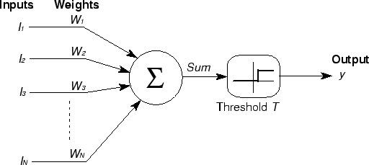
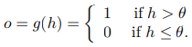
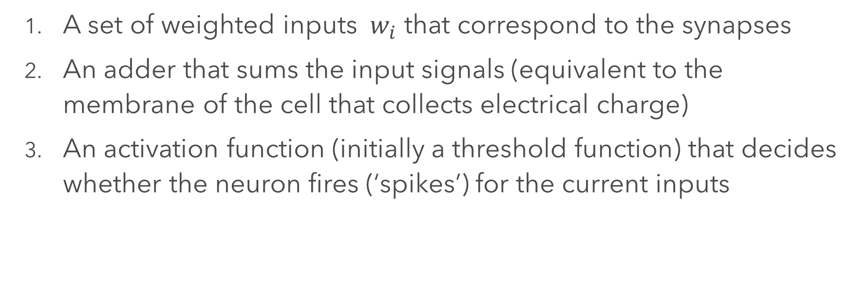

3.1.2 McCulloch and Pitts Neurons
3.1 THE BRAIN AND THE NEURON
A set of weighted inputs ${ w}_{i}$ that correspond to the synapses
An adder that sums the input signals (equivalent to the membrane of the cell that collects electrical charge)
An activation function (initially a threshold function) that decides whether the neuron fires (‘spikes’) for the current inputs
$h=\sum_{i=1}^{m}{w_{i}∗ I_{i}}$
Binary Threshold
Notes:
(Show and talk about) McCulloch and Pitts’ mathematical model of a neuron
In real neurons those inputs come from the outputs of other neurons. So the 0 means that a neuron didn’t fire. Each of these other neuronal firings flowed along a synapse to arrive at our neuron, and those synapses have strengths, called weights. The strength of the synapse affects the strength of the signal, so we multiply the input by the weight of the synapse. Now when all of these signals arrive into our neuron, it adds them up to see if there is enough strength to make it fire. We’ll write that as ( top equation)
The decision about whether or not to fire the neuron is taken by an activation function, which in simplest form can just be a binary threshold function. Above 0.5 it fires… (bottom equation)
In fact, these neurons might look simple, but as we shall see, a network of such neurons can perform any computation that a normal computer can, provided that the weights wi are chosen correctly.

Slide 4
3.1.3 Limitations of the McCulloch and Pitts Neuronal Model
3.1 THE BRAIN AND THE NEURON
Not single response but sequence of pulses
Neurons are updated asynchronously
Weights can change from positive to negative or vice versa
Synapses that link back to themselves in a feedback loop
Notes:
Real neurons do not output a single output response, but a spike train, that is, a sequence of pulses, and it is this spike train that encodes information. This means that neurons don’t actually respond as threshold devices, but produce a graded output in a continuous way. They do still have the transition between firing and not firing, though, but the threshold at which they fire changes over time. Because neurons are biochemical devices, the amount of neurotransmitter (which affects how much charge they required to spike, amongst other things) can vary according to the current state of the organism.
The neurons are not updated sequentially according to a computer clock, but update themselves randomly.
Both of these types of synapses do exist within the brain, but with the McCulloch and Pitts neurons, the weights can change from positive to negative or vice versa, which has not been seen biologically—synaptic connections are either excitatory or inhibitory, and never change from one to the other. Additionally, real neurons can have synapses that link back to themselves in a feedback loop, but we do not usually allow that possibility when we make networks of neurons.

Slide 5
3.2 NEURAL NETWORKS
3.2 NEURAL NETWORKS
Supervised learning: algorithm will learn by example
Pattern Recognition
Learning with McCulloch and Pitts neuron:
The inputs can’t change
Only the weights and the thresholds can change
Heavily reliant on
So we ask ourselves:
“How should we change the weights and thresholds of the neurons so that the network gets the right answer more often?”
Notes:
So to make the neuron a little more interesting we need to work out how to make it learn, and then we need to put sets of neurons together into neural networks so that they can do something useful.
(Supervised learning) the dataset that we learn from has the correct output values associated
Assuming that there is some pattern in the data, then by showing the neural network a few examples we hope that it will find the pattern and predict the other examples correctly. This is sometimes known as pattern recognition.

Slide 6
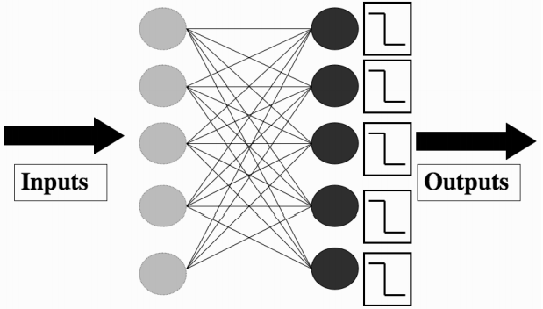
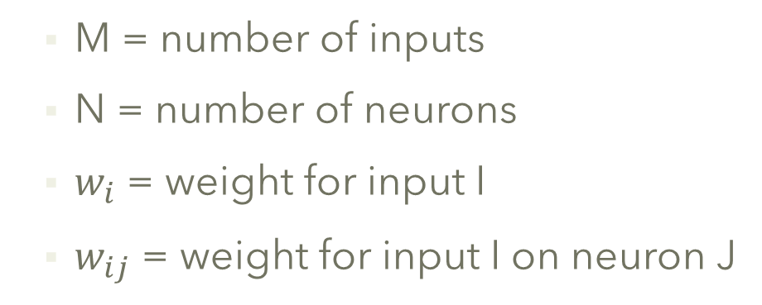
3.3.1 THE PERCEPTRON
3.3 THE PERCEPTRON
A collection of independent McCulloch and Pitts neurons but train on all inputs.
M = number of inputs
N = number of neurons
$w_{i}$ = weight for input I
$w_{ij}$ = weight for input I on neuron J
Input nodes
Neurons
Pattern of Non/firing = weighted input + activation + thresholding
Then compare pattern to target
Notes:
Input nodes: These are not neurons, they are just a nice schematic way of showing how values are fed into the network.

Slide 7

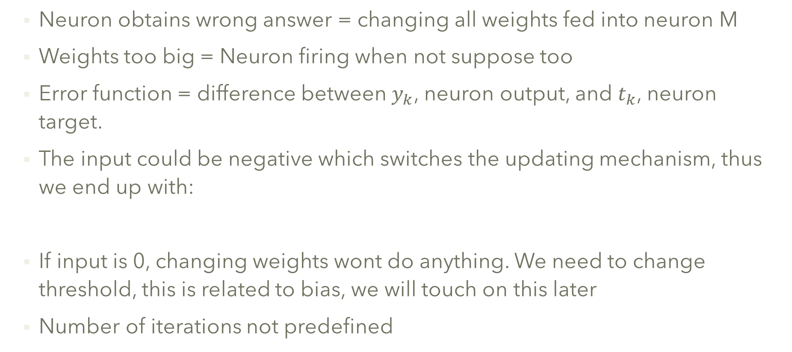
3.3.1 THE PERCEPTRON Cont.
3.3 THE PERCEPTRON
Neuron obtains wrong answer = changing all weights fed into neuron M
Weights too big = Neuron firing when not suppose too
Error function = difference between $y_{k}$, neuron output, and $t_{k}$, neuron target.
The input could be negative which switches the updating mechanism, thus we end up with:
If input is 0, changing weights wont do anything. We need to change threshold, this is related to bias, we will touch on this later
Number of iterations not predefined
Notes:
Learning rate = how much to change the weights by.

Slide 8

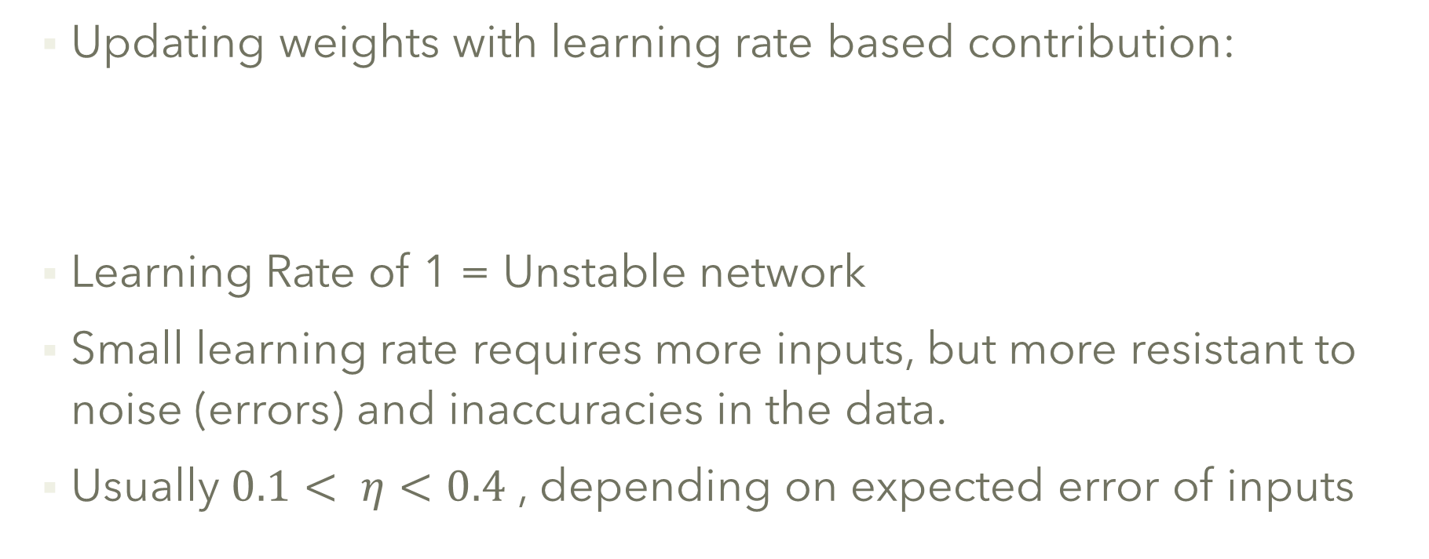
3.3.1 The Learning Rate η
3.3 THE PERCEPTRON
Updating weights with learning rate based contribution:
Learning Rate of 1 = Unstable network
Small learning rate requires more inputs, but more resistant to noise (errors) and inaccuracies in the data.
Usually $0.1< η<0.4$ , depending on expected error of inputs
Notes:
1 unstable as wrong predictions will generate drastic weight changes.

Slide 9
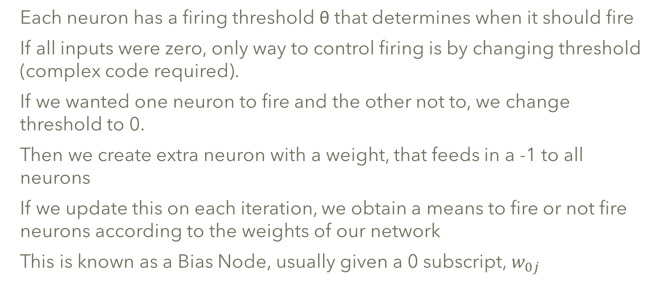
3.3.2 The Bias Input
3.3 THE PERCEPTRON
Each neuron has a firing threshold θ that determines when it should fire
If all inputs were zero, only way to control firing is by changing threshold (complex code required).
If we wanted one neuron to fire and the other not to, we change threshold to 0.
Then we create extra neuron with a weight, that feeds in a -1 to all neurons
If we update this on each iteration, we obtain a means to fire or not fire neurons according to the weights of our network
This is known as a Bias Node, usually given a 0 subscript, $w_{0j}$

Slide 10
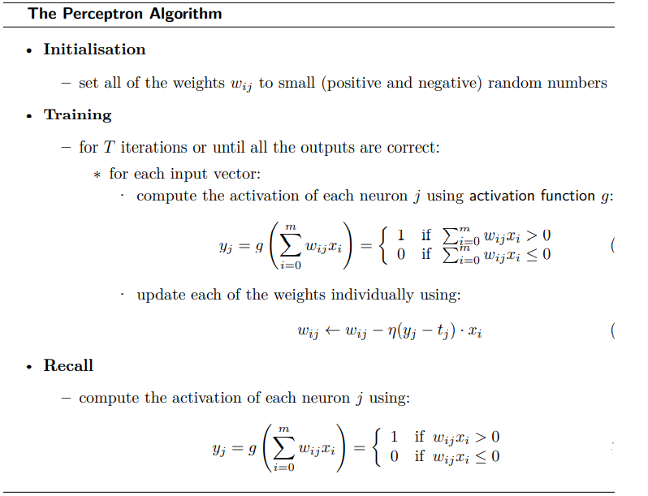
3.3.3 The Perceptron Learning Algorithm
3.3 THE PERCEPTRON
Notes:
The algorithm is separated into two parts: a training phase, and a recall phase. The recall phase is used after training, and it is the one that should be fast to use, since it will be used far more often than the training phase. You can see that the training phase uses the recall equation, since it has to work out the activations of the neurons before the error can be calculated and the weights trained.
Computing the computational complexity of this algorithm is very easy. The recall phase loops over the neurons, and within that loops over the inputs, so its complexity is O(mn). The training part does this same thing, but does it for T iterations, so costs O(Tmn).

Slide 11
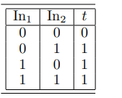
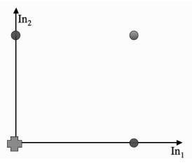
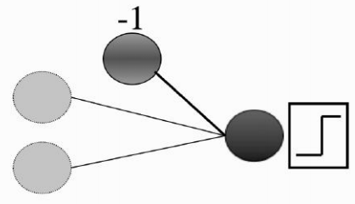
3.3.4 An Example of Perceptron Learning: Logic Functions
3.3 THE PERCEPTRON
The logical OR
2 input node, 1 bias node(weight = -1), 1 neuron ,1 output node
3 initialised weights : w0 = −0.05, w1 = −0.02, w2 = 0.02
Value at neuron = −0.05 × −1 + −0.02 × 0 + 0.02 × 0 = 0.05, which is > 0, so neuron fired
Target is 0, neuron did not have to fire…

Slide 12
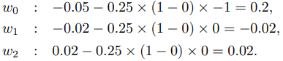

3.3.4 An Example of Perceptron Learning: Logic Functions Cont.
3.3 THE PERCEPTRON
We now use the following equation to update the weights:
We then do the same for the next line of the logical OR problem
Once 1 run through the data is complete we start going through the inputs again, until the weights settle down and stop changing.
There is arrange of weight that an algorithm can converge too and these depend on learning rate, the inputs, and the initial starting values

Slide 13
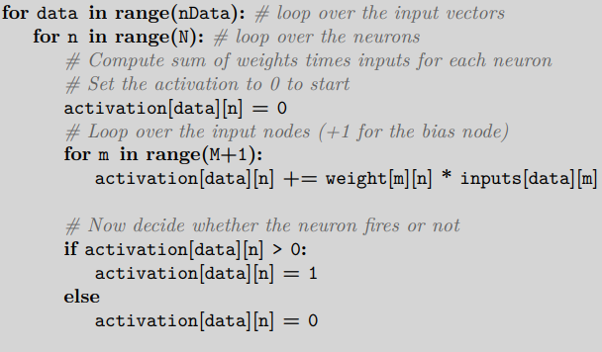
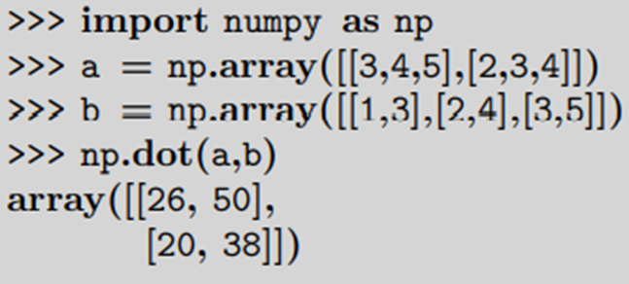
Implementation 1
Arrays: Inputs(batches of nData), weights, outputs and targets
Input vector: list of values presented to the perceptron (nodes)
On the left we have one loop that runs through all the inputs, with an inner loop running through all the neurons
M = number of inputs + 1 (bias node)
N = number of neurons
When multiplying matrices we need dimensions to be a such:
A = m x n
B = n x p
AB matrix will be = m x p
Row of A multiplied by column of B until all row/columns complete.
We can do the multiplication with numpy.dot()

Slide 14
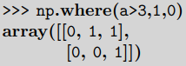
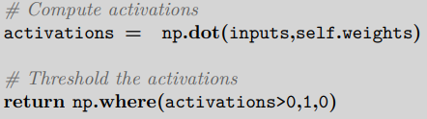
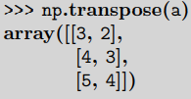



Implementation 2
np.where(condition,x,y) that returns a matrix that has value x where condition is true and value y everywhere else.
Once the activation matrix is calculated we can then threshold with the np.where function.
This leaves us with the need to compare the inputs, targets and final but, as the dimension are not adequate for a multiplication we must use a transpose function
Once that is done the weight update can be done in one line, where eta = learning rate…
We then use np.concatenate to add those extra -1’s onto the input vectors for the bias node.
Finally, we give initial values to the weights, to get algorithm going.
Notes:
If we do, then the output will be an N ×n matrix that holds the values of the sum that each neuron computes for each of the N input vectors

Slide 15
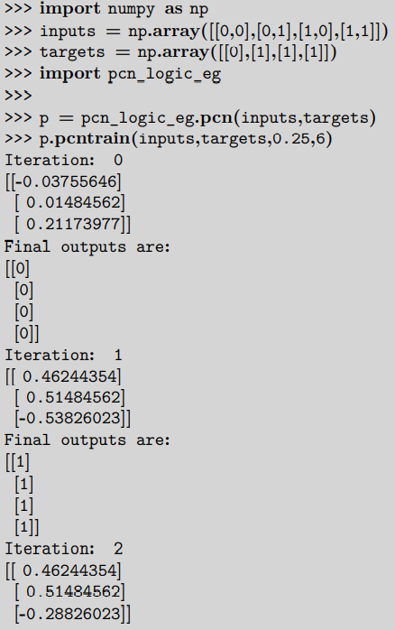
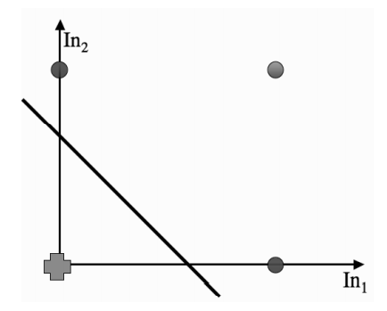
Implementation 3
With complete structure built we put it all together in a class and load a function into the final script.
Before returning the outputs the algorithm returns the modified weights of the neural network
Then we obtain a graph which show the decision boundary as below.
In terms of learning about a set of data we have now reached the stage that neural networks were up to in 1969.

